Slide 1

The Learning Curve of a Just Culture
By: Taib Elbaroudi
07/14/2024

Slide 2

What is a Just Culture?
"Just Culture" refers to a system of shared accountability in which organizations are accountable for the systems they have designed and for responding to the behaviors of their employees in a fair and just manner.

Slide 3
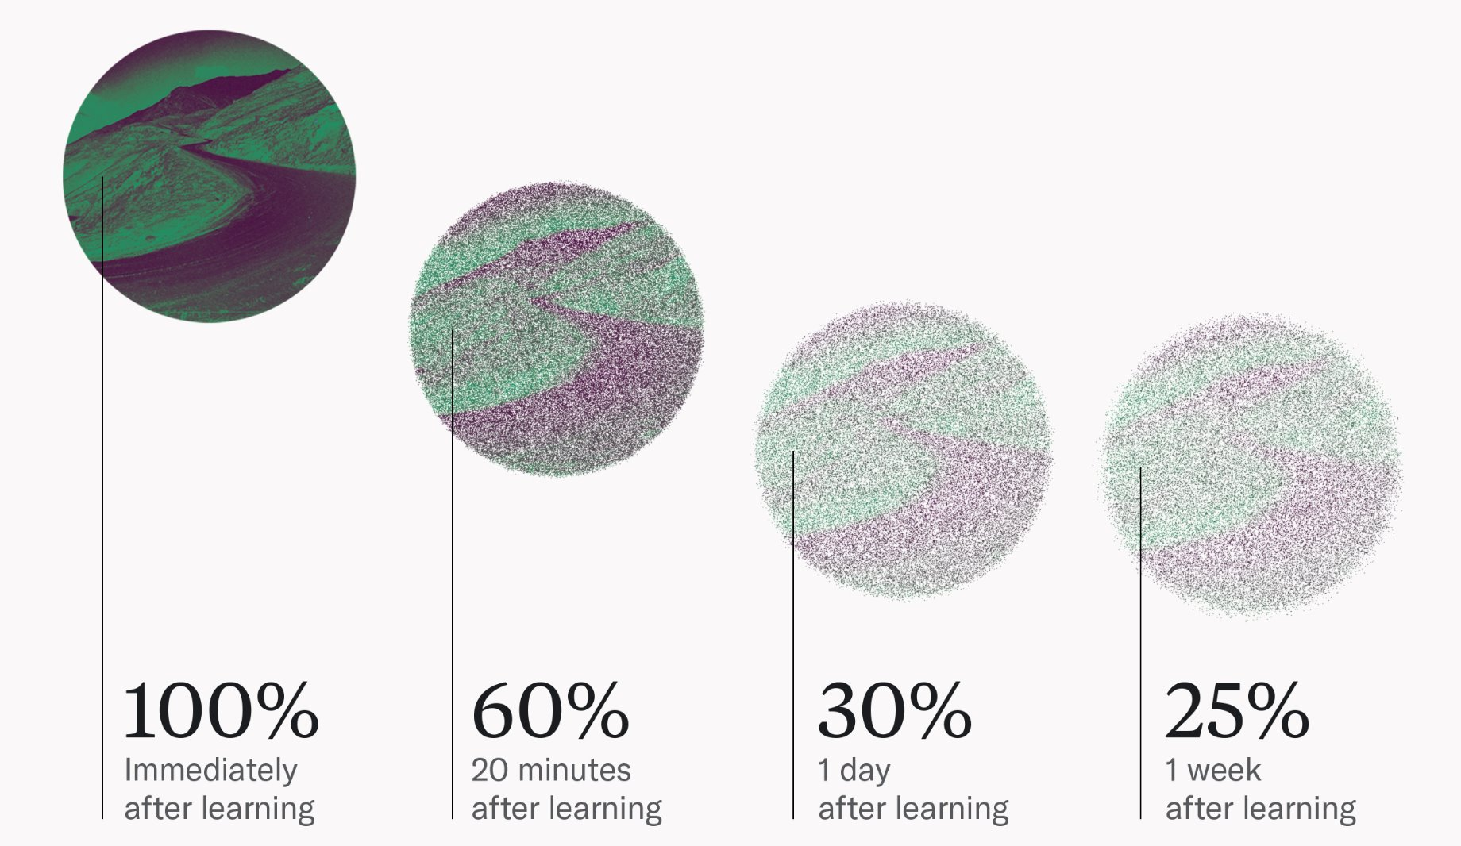
What Is a Learning Curve?
A learning curve is a mathematical concept that graphically depicts how a process is improved over time due to learning and increased proficiency. The learning curve theory is that tasks will require less time and resources the more they are performed because of proficiencies gained as the process is learned.

Slide 4
Implementation of a Just Culture
Establishing a just culture in an organization is a continuous process that involves three main areas of action:​
Building awareness​
Implementing policies​
Integrating just culture principles into daily work

Slide 5
Steps for Implementation
Define and communicate expectations
1
Provide training and support
2
Monitor and evaluate outcomes
3
Recognize and reward achievements
4
Address and overcome challenges
5
Seek and share best practices
6

Slide 6
Barriers and Challenges
Fear of punishment
Lack of trust
Resistance to change
Lack of leadership commitment
Lack of resources

Slide 7
Best practices to overcome the challenges:
Creating a culture of transparency and openness by encouraging employees to report errors and near-misses without fear of punishment (Dekker, 2011)
Building trust by involving employees in the process of creating a Just Culture and being open and honest about the causes of errors and near-misses (Vincent, 2016)
Addressing resistance to change by involving employees in the process of creating a Just Culture and providing training on the benefits of the approach (Hofmann & Jones, 2018)
Providing leadership commitment by involving leaders in the process of creating a Just Culture and holding them accountable for creating a culture of safety (Reason, 2000)
Providing resources such as training, error reporting systems and staff time to review errors and near-misses (Hofmann & Jones, 2018). Alongside Freedom to Speak Up Guardians, implementation of Just and Learning Ambassadors to support and hold all accountable.

Slide 8

Conclusion
Overall, by following the Just Culture's best practices mentioned in this presentation, organizations can create an environment where errors are reported without fear of blame leading to a significant improvement and lasting impact.

Slide 9

Resources:
https://www.investopedia.com/terms/l/learning-curve.asp#:~:text=A%20learning%20curve%20is%20a,as%20the%20process%20is%20learned.
https://maestrolearning.com/blogs/what-is-the-learning-curve-2/#:~:text=The%20learning%20curve%20shows%20that,percent%20of%20what%20they%20learned.
https://www.brighamandwomensfaulkner.org/about-bwfh/news/what-is-just-culture-changing-the-way-we-think-about-errors-to-improve-patient-safety-and-staff-satisfactionhttps://psnet.ahrq.gov/perspective/making-just-culture-reality-one-organizations-approach
https://www.linkedin.com/advice/0/what-benefits-challenges-implementing-8f#:~:text=Provide%20training%20and%20support%20The%20second%20step,causal%20analysis%2C%20risk%20assessment%2C%20and%20improvement%20actions.

